Slide 1
AI’s Impact on the 2024 Presidential Election
By Kaeden Stander, Jeff Lange and Daniel Laverty

Slide 2
Subject Framing
Think back voting (hopefully) in the 2024 election…
How concerned were you about being deceived by AI generated media?
How concerned were you that other people were being deceived?
Big Question:
How did the American public and other important stakeholders perceive the impact and regulation of AI in the 2024 presidential election, and what transparency focused policies can we develop to keep regulation on pace with AI development?

Slide 3
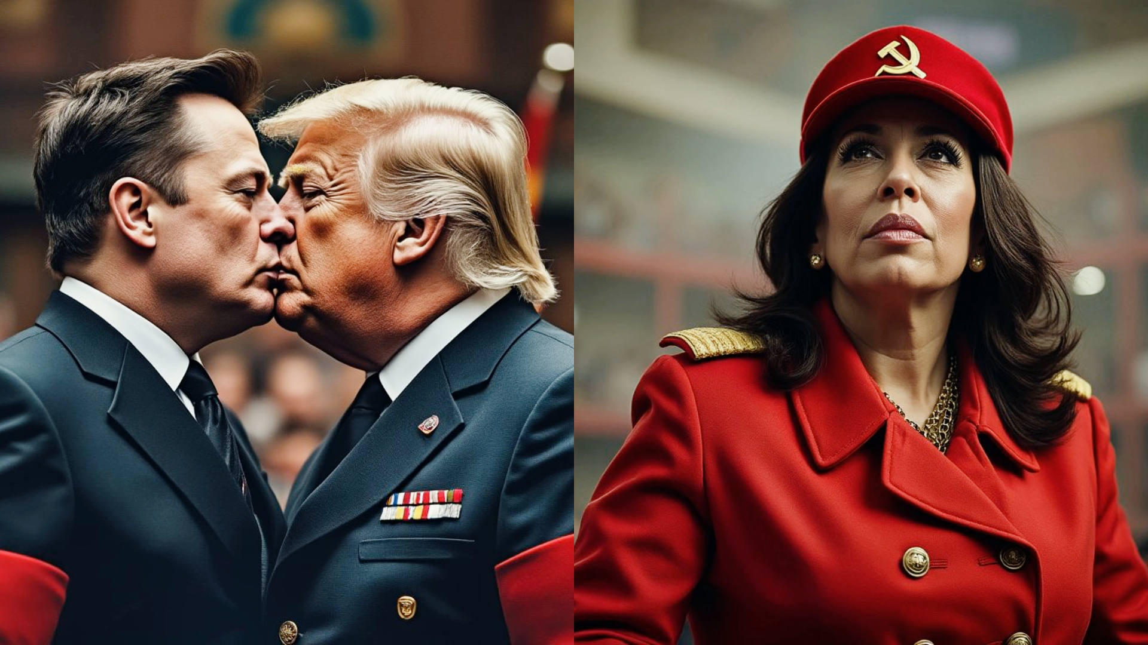
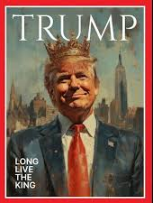
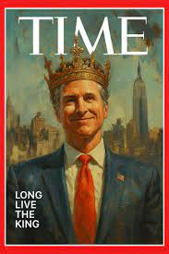
This is happening
Posted on Truth Social by the President
Rebuttal posted on X by Gavin Newsom
Posted by Elon Musk on X
Notice how none of them have AI indicators…

Slide 4
01
Our Approach
In our research and policy design we wanted to center around a place where we…
Create Universal AI regulation suggestions.
Ensure no one stakeholder group faced unfair disadvantages / dis-affordances
Limit the disconnect between AI platforms and the general public
To do this we…
Analyzed sentiment from statements given by each stakeholder group (Codebook + Annotated bibliography)
Launched a public survey
Performed Ethical Analysis

Slide 5

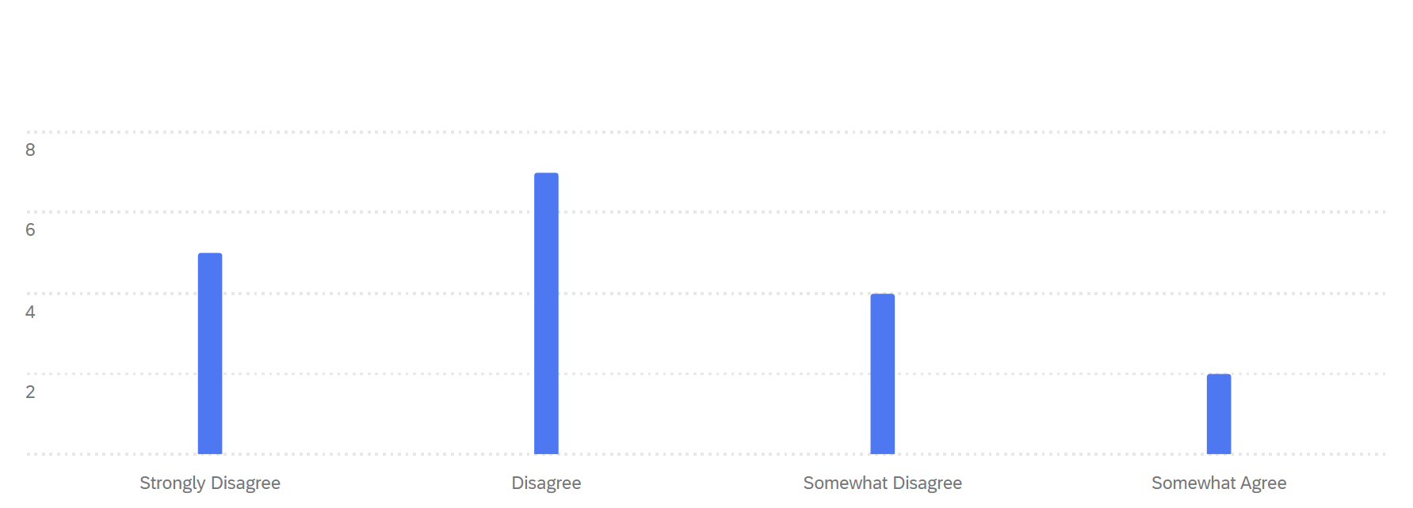
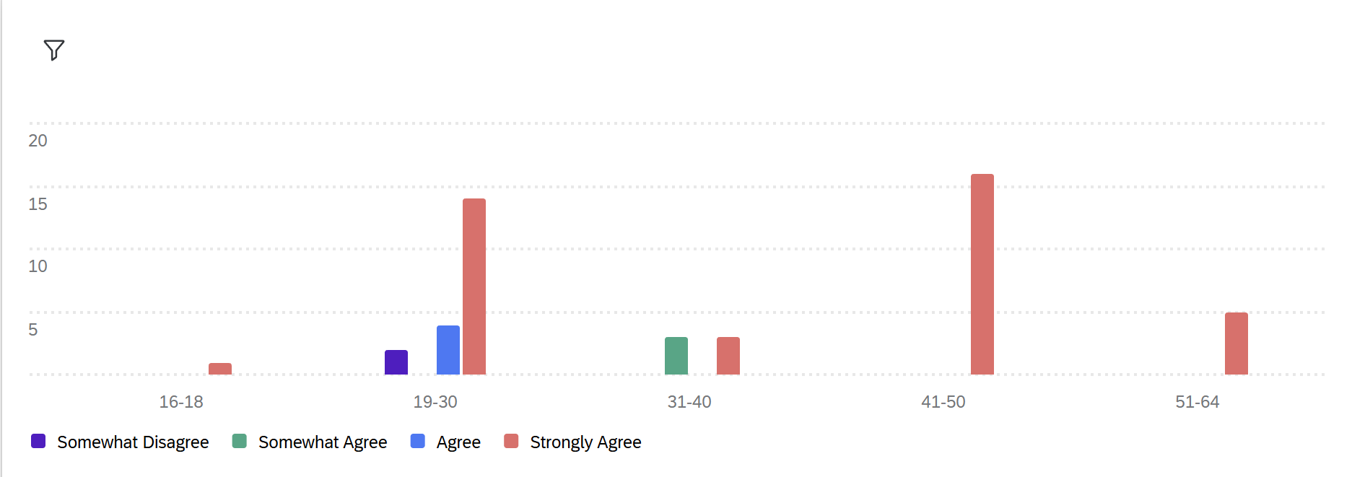
02
Survey Results
A tri-university study discovered participant support for halting AI development rose from 29% → 38% after seeing AI disinformation examples (Jungherr et al., 2024).
Our own survey had similar conclusions, with the majority of respondents lacking faith in AI moderation
Should there be stronger regulation around AI usage in elections and politics?
I felt confident that online platforms effectively monitored and labeled synthetic media to prevent misinformation during the election.
Somewhat Disagree
Agree
Somewhat Agree
Strongly Agree
*Grouped by age range

Slide 6

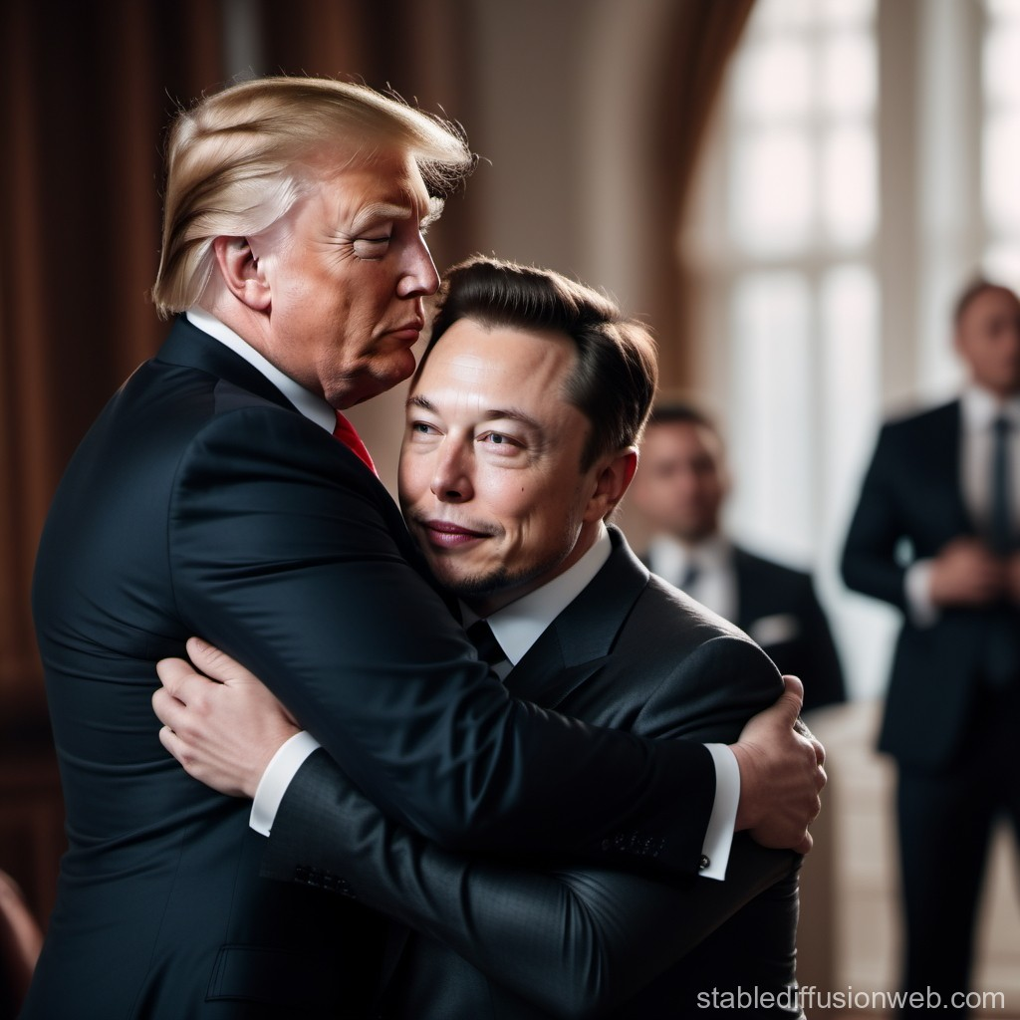
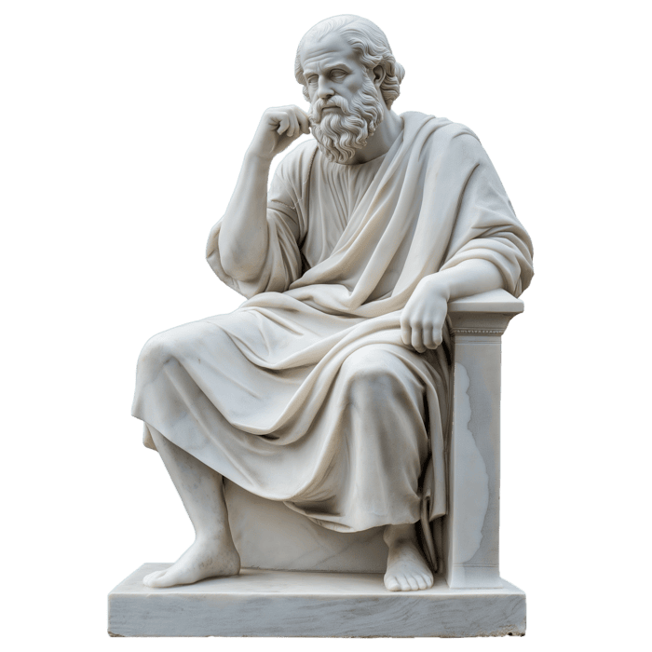
03
Ethical Analysis
Utilitarianism (The Greater Good): Regulation reduces mis/disinformation; public benefits most, while big tech and political parties face greater burdens.
Deontology (Duties and Rules): Regulation promotes fairness but risks being seen as censorship or a First Amendment issue.
Virtue Ethics (Good Moral Character): Focuses on values and habits; key solution is transparency.
  Politicians using disclaimers for AI content.
Conclusion: Virtue ethics is the strongest framework, as transparency policies protect rights, inform the public, and avoid overregulation.

Slide 7
03
Policy Proposal
Concepts of a plan
Visual Synthetic Media
  Standardized watermarks
  Metadata indicators
Audio Synthetic Media
  Audible AI disclosure
  Legal prosecution
Political Transparency
  Campaign’s public AI database listing:
    Every instance of synthetic media
    Platforms distributed to
    Date of creation
  Ensures AI does not become a hidden part of political messaging
Policy Objective
Protect election integrity while maintaining the people’s freedom of speech
Notes:
Visual Synthetic Media
Mandatory and standardized on screen watermark
AI platforms must embed metadata indicators that trigger platform level disclosure
Audio Synthetic Media
Mandatory audible AI disclosure, similar to pharmaceutical advertisements
Content missing disclosure can be legally prosecuted
Political Transparency
Campaigns using AI must maintain a public database listing:
Every instance of synthetic media used in campaigns
Platforms distributed to
Date of creation
Ensures AI does not become a hidden part of political messaging

Slide 8
Future Directions…
Rapid advancements in AI make future impacts hard to predict.
Deep fakes and voice synthesis are becoming increasingly realistic and harder to identify.
Raises major questions for future elections: campaign strategies, debates, and voter trust.
AI is already being used for political gain outside of elections, including deepfake-based attacks.
Next step: broader AI policy focused on preventing defamation, discrimination, and incitement of violence.
Future policy must evolve alongside AI without restricting democratic participation.

Slide 9
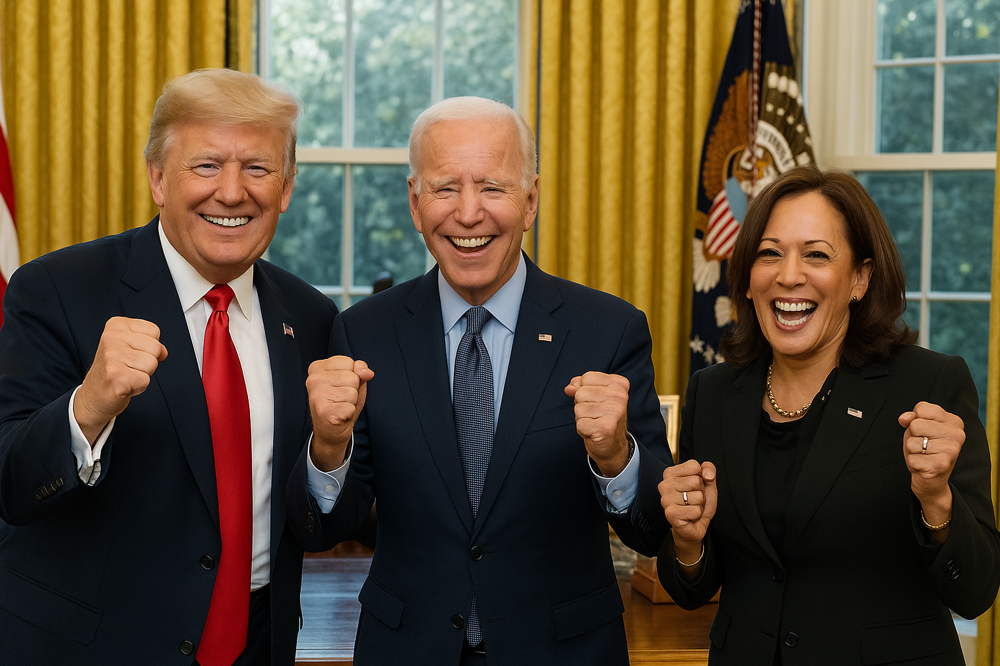
Thank you!!!

